Slide 1
Springer Nature: New content and solutions
AMICAL 2016
  Rome, May 12th 2016

Slide 2





A strategic merger between three famous publishers
Notes:
Bringing together dynamic publishing houses with more than 150 years of history behind them
Springer Science and Business Media – owned by funds managed by BC Partners
NPG – publisher of the world famous Nature journal
The majority of MSE global businesses –owned by Holtzbrinck Publishing Group
Springer Nature is one of the largest science publishers by number of journals, the largest open access publisher and the largest academic book publisher in the world:
#1 OA publisher - we publish over 500 fully OA journals and expect to publish over 60k articles this year;
#1 book publisher - over 170k digitised and 11k+ new books published last year across the Springer Nature portfolio;
#1 journal provider by volume - over 3000.

Slide 3







Uniting some of the best known brands in our field
Notes:
Springer Nature is home to an array of respected and trusted brands with long histories and track records, across science and the social sciences.

Slide 4



























Home to a breadth and depth of imprints, journals and products
Notes:
As a newly enlarged organisation, we can think bigger, act bolder and achieve more for institutions, academic researchers, students, teachers and professionals - in all our markets across the world.
In addition to our well known brands in science:
Our Education group is a widely recognized and respected name in global language learning, schools and higher education businesses, whose brands have become household names around the world;
Our Professional group offers a full range of products, from print to events, aimed at supporting their customers’ professional learning in fields such as medicine, engineering and transport.

Slide 5


Our leading brands
Established in 1842 and a leading global scientific, technical and medical publisher, providing researchers in academia, scientific institutions and corporate R&D departments with quality content via innovative information products and services. Springer has one of the most significant STM eBook collections and archives, as well as a comprehensive portfolio of open access journals. |  | Founded in 1869, Nature is the world’s most cited scientific journal, with over half a million citations a year. It is the number one multidisciplinary science journal globally with an Impact Factor of 41.456. Nature reaches millions of scientists and students at 4000 institutions worldwide, each month 3.5 million unique users view more than 8 million pages on Nature’s website. |  | Macmillan Education is the third largest global provider of English language publishing in the world, a local K12 publisher and through Palgrave, a publisher and distributor of renowned higher education titles. Together they serve customers in 50 markets and supply high-quality content and innovative digital products and services to customers in 120 countries around the world.
The largest open access publisher in the world, publishing over 286 peer reviewed open access journals across the fields of biology, biomedicine and medicine. With over 1.8 million registrants, BioMed Central can provide targeting opportunities across a range of specialities, job titles and disciplines. | A technical publisher devoted to meeting the needs of those in the information technology field. With more than 1,500 books in print and e-formats, Apress is the authoritative source for IT professionals, software developers, programmers and business leaders around the world. |  | Founded in 1845, Scientific American is the oldest continuously published magazine in the U.S. and the leading source and authority for science, technology information and policy for a general audience. The print edition is read by 3.5 million worldwide consumers and ScientificAmerican.com has an average of 5.5 million views every month. |  | A global academic and business publisher for the Humanities and Social Sciences (HSS). Palgrave Macmillan is the first boundary-free HSS publisher - working at all lengths and across all business models. It offers readers and authors a single source for the best in professional learning and scholarship.

Slide 6
Our science business imprints and products
Nature Research Group | Springer Research Group | Open Research Group
Nature Nature Research Journals Scientific American Spektrum Scientific American MIND Nature Index Nature Methods Nature Protocols Nature Reviews Nature Jobs Nature Conferences Nature Masterclasses Nature Education Springer Shop Springer Protocols SpringerMaterials Adis Insight Macmillan Science Communication Macmillan Medical | Springer Birkhäuser Chemistry Central Springer Gabler Springer Spektrum Springer Vieweg Springer VS SpringerReference Apress Open Choice Palgrave Macmillan NPG Academic Journals zbMATH | BioMed Central SpringerOpen SpringerPlus (is a journal of SpringerOpen) Nature Communications Scientific Reports Scientific Data NPJs Palgrave Communications

Slide 7
Focused on science, education and professional publishing
*By revenue
Notes:
By bringing together the best of both worlds and by using our combined expertise, scale and the reach of our brands, we aim to grow, innovate and do more than we could as separate companies - particularly to meet the needs of our customers and partners.

Slide 8
Based where our customers need us to be
*employees
Europe
c4700
c1750
c400
<10
c100
<50
United Kingdom
Netherlands
Denmark
Poland
c50
Russia
Asia
Pacific
c5900
North America
c950
c1750
<10
<10
Austria
Germany
Sweden
Czech Republic
c100
<10
<10
Switzerland
Ukraine
Kazakhstan
<50
c950
c150
<10
c200
United States
France
Spain
Turkey
Bulgaria
Japan
c600
c300
<10
c50
c150
China
South
Korea
Mexico
<10
c50
Slovakia
Israel
<10
<10
Honduras
<10
Italy
c5250
Taiwan
Guatemala
Nicaragua
c50
India
c100
<10
<10
Egypt
<10
<10
Hong Kong
El Salvador
<10
Panama
<10
UAE
Dubai
Thailand
<10
<50
Costa Rica
Africa
c250
Jordan
<10
Vietnam
Colombia
<10
Malaysia
<50
Ecuador
Peru
c100
Singapore
<50
Brazil
c50
c100
Latin
America
c950
<10
Namibia
<50
Australia
Chile
Argentina
<50
Zimbabwe
c150
Botswana
<50
c50
c100
<10
Swaziland
South Africa
Lesotho
New Zealand
Please note - Numbers have been rounded
Notes:
Complementary geographic footprints and brand portfolios
Growing in growing markets
Our combined global footprint reflects our expanded geographic reach - with just under 13,000 people in over 50 countries, this scale is enhanced by local support from our teams of knowledge experts all over the world.

Slide 9
With a simple ambition
To help researchers, students, teachers and professionals to achieve and discover more..
Notes:
We believe we are now uniquely positioned to make a positive impact by:
Bringing more research to the world through the breadth and depth of our offering;
Combining our respected and trusted brands, home to knowledge experts; and
By being a proactive partner, taking a progressive lead in areas such as open research and policy.

Slide 10
What this means for the research community
For… | This means…
Librarians | More choice under one roof offering better value, superior service and enhanced data and analytics to help you optimise the use of your budgets.
Societies and publishing partners | Support from a new organisation that unites leading academic publishers who share a strong commitment to providing quality and choice to the research community.
Researchers as authors | Easier and faster submission; a consistent high quality peer review process and seamless access to a wide range of publication options.
Readers | Better platforms, enhanced discoverability, functionality and work-flow tools as well as access to more titles across a wider range of content and with a better and more integrated reader experience.
Sponsors and advertisers | More choice of inventory and solutions, enhanced global support and even better reach.

Slide 11
    What about the Springer Nature eBooks?

Slide 12

Leading eBook Publishers: total number of eBooks available
Number of English-Language eBooks Available (as of April 2015)
Data from publisher websites; Taylor & Francis: numbers from CRCNetBase and T&F eBooks sites

Slide 13
Springer Nature: the most relevant publishers in STM e HSS
eBooks in English language in 2014
6.725
4,888
2,344
2,216
1,707
1,311
1,207
757
271
Data from www.puballey.com; only books available through YBP approval plans; if a book is published simultaneously in hard- and paperback editions, only the hardback edition was included

Slide 14
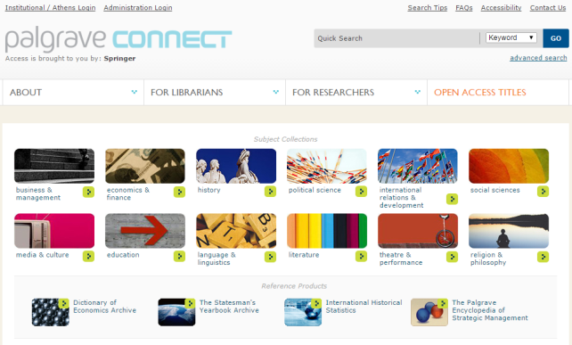
Palgrave eBooks: the content
  More than 10,000 eBooks (2005-2015)
12 eBook subject collections in the following areas:
    Humanities, Social Sciences, Business &Management

Slide 15
Springer eBooks: the content
  Almost 200.000 ebooks
  13 subject collections contemporary (≥ 2005)
    English and German language
    Copyright year
    Including eBookSeries and Major Reference Works
  24 Contemporary eBook series (≥ 2005) ad es Lecture Notes
  11 Springer eBook Archives (<2005)
  21 eBookSeries Archives (<2005)
  Major Reference Works (pick and choose)

Slide 16

How the integration took place?
Migration of eBooks from Palgrave Connect to Springerlink
Alignment of the subject classifications
Alignment of the business models and product characteristics
Metadata conversions - Access Setup
Features development (MyCopy, POD, eBooks)

Slide 17
2016 eBook packages: The changes
12 Palgrave Collections
Humanities, social science + law
Business + economics
Springer Humanities & Social Sciences Complete Collection
Behavioral Science
Packages no longer available as of copyright year 2016 are:
  Humanities, Social sciences and Law
  Behavioral Sciences
  Business and Economics
Palgrave content available on SpringerLink

Slide 18
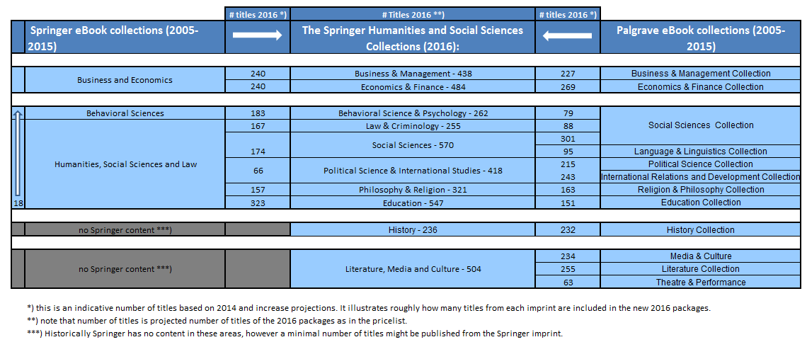
The new packages: the Humanities and Social Science Collections

Slide 19
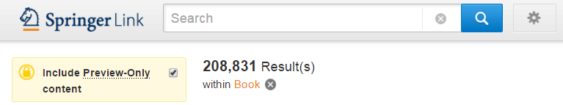
Springer and Palgrave eBooks 2016
  10 eBook subject collections in Science, Technology and Medicine
  10 eBook subject collections in Humanities, Social Sciences and Business & Economics
  More than 12,000 eBooks per year

Slide 20
The Subject Collections 2016
The Springer Nature Humanities and Social Sciences Collection |  |  | The Springer Nature Science, Technology and Medicine Collection
Behavioral Science & Psychology | +260 |  | Biomedical & Life Science | +640
Business & Management | +430 |  | Chemistry & Materials Science | +300
Economics & Finance | +480 |  | Computer Science | +1100
Education | +450 |  | Earth & Environmental Science | +390
History | +230 |  | Energy | +130
Literature, Cultural & Media Studies | +500 |  | Engineering | +930
Political Science & Internl. Studies | +410 |  | Mathematics & Statistics | +545
Philosophy & Religion | +320 |  | Medicine | +785
Social Sciences | +560 |  | Physics & Astronomy | +420
Law & Criminology | +250 |  | Professional & Applied Computing | +230

Slide 21

Main carachteristics of our offer
Available on Springerlink only:
  Textbooks
  Major Reference Works
  Major series, e.g. Lecture Notes in Computer Science, Math, etc.
  Springer Book Archives
Perpetual access – archival rights
Unlimited access

Slide 22


Features…
MyCopy
  Print on demand softcover editions for only 24.99.
BookMetrix ™
  Assess the performance of a book by citations, mentions, readers, reviews and usage.
  MARC records (OCLC)
  All new titles on SpringerLink will have Springer and OCLC MARC records at no extra charge. See springer.com/marc for more information

Slide 23
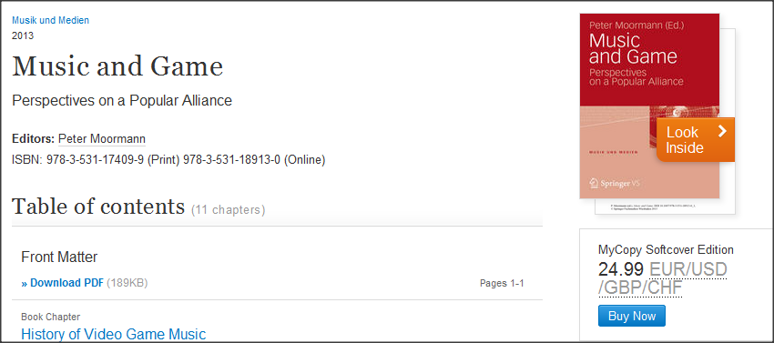
MyCopy
Print on Demand books from your Springer eBook Collections
Users order directly & ONLY from SpringerLink (not through the library)
For only $24.99 (including shipping!)
No extra charge and no extra work for the library
Soft cover is 4-color and inner work is black & white

Slide 24
Springer eBooks can be downloaded by chapter or as whole books

Slide 25

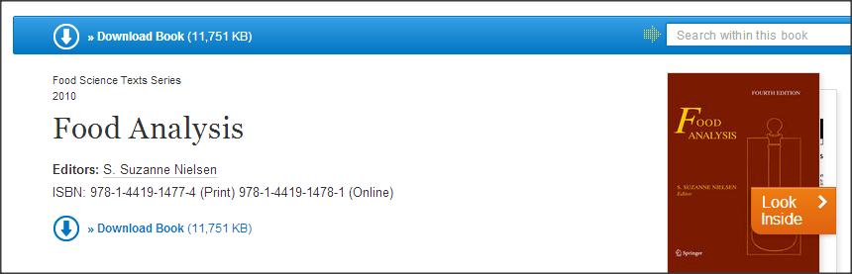
Download or search the whole book
Note, if the book has >100 chapters, the option doesn’t appear

Slide 26
Springer licenses offer flexible terms
Provisions for Interlibrary Loans (ILLs) of book chapters
Text & data mining
Use in coursepacks

Slide 27
Dedicated support resources:
General help: onlineservice@springer.com
SpringerLink Feedback Community: http://feedback.link.springer.com/springer_rd
MARC record questions: MARC@Springer.com
Discoverability support: discovery@springer.com

Slide 28
How to contact us: http://www.springer.com/it/librarians/contact-us
Questions?
Thank you!
Andrea Testa
Licensing Manager, Italy

