Slide 1
Top Trends for Technologies in Higher Education
Joan K. Lippincott, CNI
AMICAL Kosovo 2014

Slide 2
Trends to watch
Flipped classroom
Mobile technologies
  Smartphones, tablets
  Wearable devices
Makerspaces
Games and gamification
Learning analytics

Slide 3
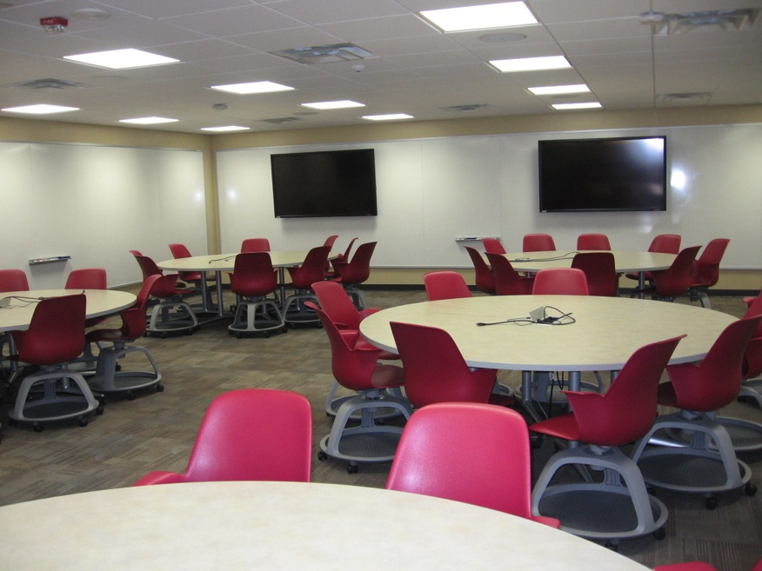
Flipped classroom
Virginia Tech Library Classroom

Slide 4
Why important
Demonstrated success in improving student learning
Develops a variety of skills in addition to learning disciplinary content
  Problem solving
  Group collaboration

Slide 5
Other considerations
Is technology critical or can this be implemented without technology?
Will faculty adjust their pedagogy?
Can you provide training opportunities and/or incentives for curricular change?

Slide 6
Assessments of learning in flipped classrooms
http://web.mit.edu/edtech/casestudies/teal.html
http://scaleup.ncsu.edu/FAQs.html
http://www.oit.umn.edu/research-evaluation/selected-research/learning-environments/index.htm

Slide 7
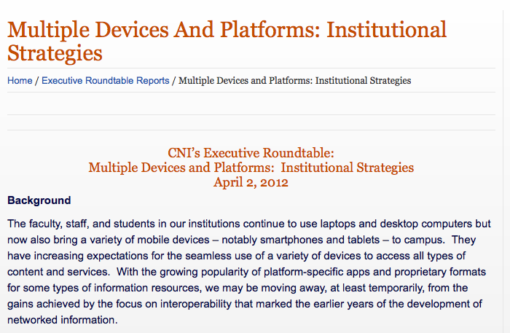
Smartphones and tablets
http://www.cni.org/executive-roundtable-reports/multiple-devices-and-platforms-institutional-strategies/

Slide 8
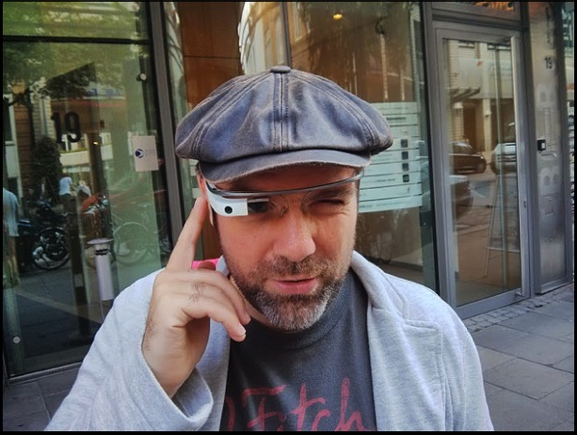
Wearable devices
GoogleGlass
FitBit
Michael Praietorius
http://www.flickr.com/photos/75167935@N00/9408562753

Slide 9
Why important
Multi-purpose tools
Costs lower / capabilities increase
More content will be available
More production capabilities will arise
Useful for fieldwork, clinical work

Slide 10
Other considerations
Standardization of devices
Rate of adoption by faculty and students
Security
Proprietary platforms for content

Slide 11
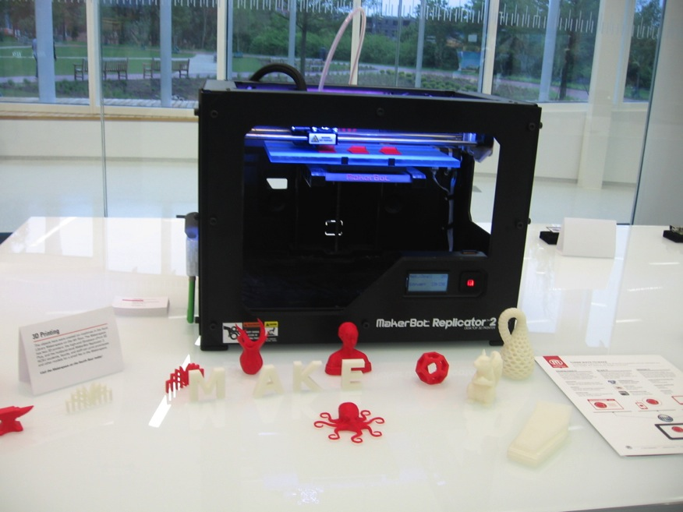
Makerspaces
North Carolina State U. Hunt Library 3-D Printer

Slide 12
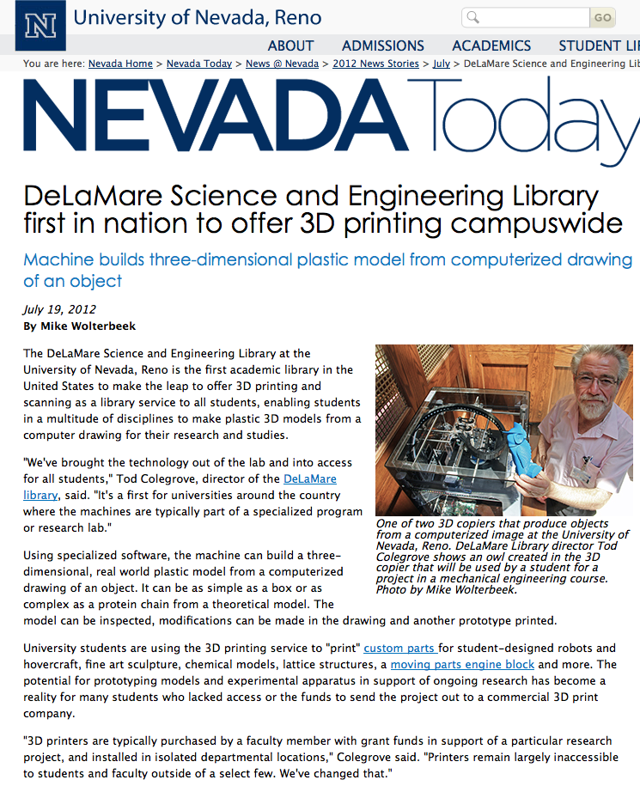
Why important
“3D printing enriches learning and promotes knowledge creation.” Kathlin Ray, Dean, University Libraries, University of Nevada, Reno http://www.slideshare.net/klray/academic-libraries-as-makerspace-3d-printing-at-and-3-d-printing-public
http://www.unr.edu/nevada-today/news/2012/3d-copier

Slide 13
Other considerations
Are there clear links to the curriculum?
  Engineering
  Environmental studies
  Health sciences
  Archaeology
Equipment and staff costs
Expertise

Slide 14
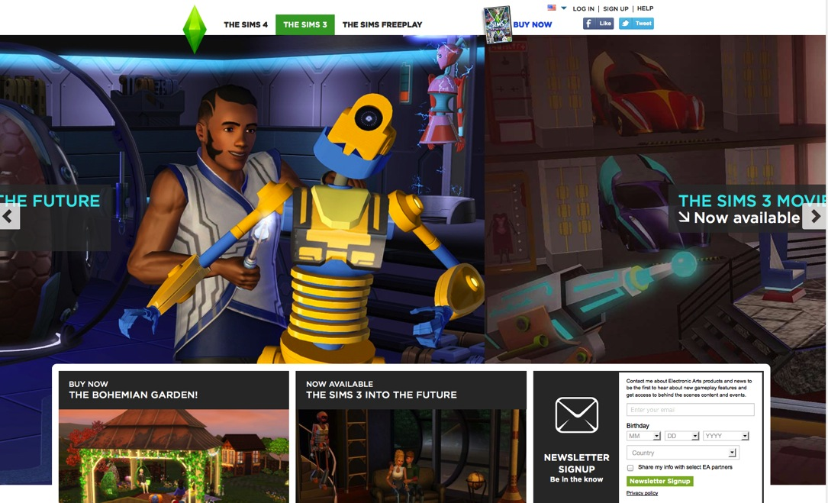
Games and gamification
http://www.thesims.com/en-us/the-sims-3#

Slide 15
Why important
Considered by many to be a useful strategy
  Engagement
  Active learning
  Developing strategic thinking
  Increasing learning

Slide 16
Other considerations
If using existing games, not all students will enter with same skills or interests (WOW, etc.)
Game development is very expensive
Few good products for the higher education sector

Slide 17
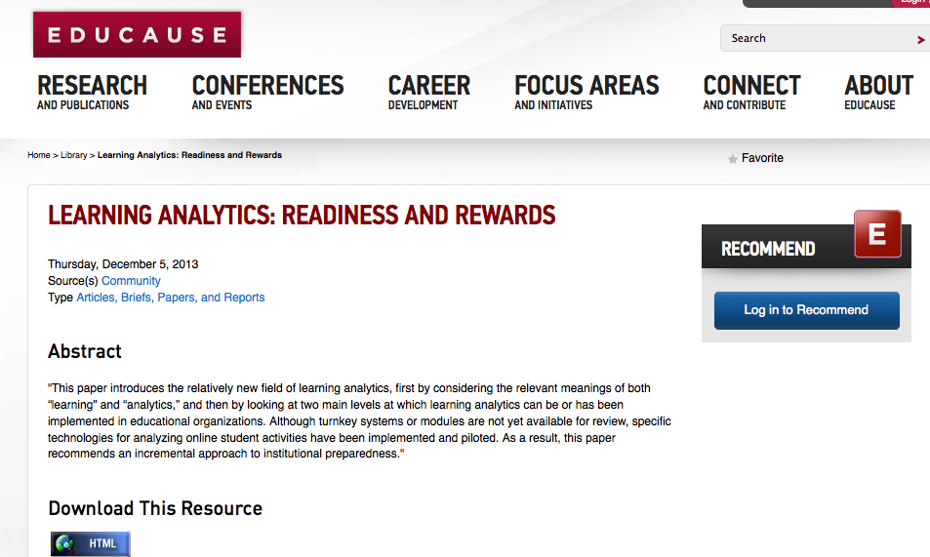
Learning analytics
http://www.educause.edu/library/resources/learning-analytics-readiness-and-rewards

Slide 18
Why important
Could help more students succeed and persist to degree
Could have particular implications for STEM
Addresses accountability

Slide 19
Other considerations
Resource-intensive
Works best for very large classes
Need strategies for following up on what data reveals
  For faculty – pedagogy
  For students – support services

Slide 20
Resources
Horizon Report http://www.nmc.org/publications/2014-horizon-report-higher-ed
Pew Internet and American Life Project www.pewinternet.org/‎
EDUCAUSE www.educause.edu

Slide 21
Discussion
What do you think about the trends identified?
Would you like to discuss others?
  MOOCs
  Open Educational Resources (OER)
  Data visualization

Slide 22
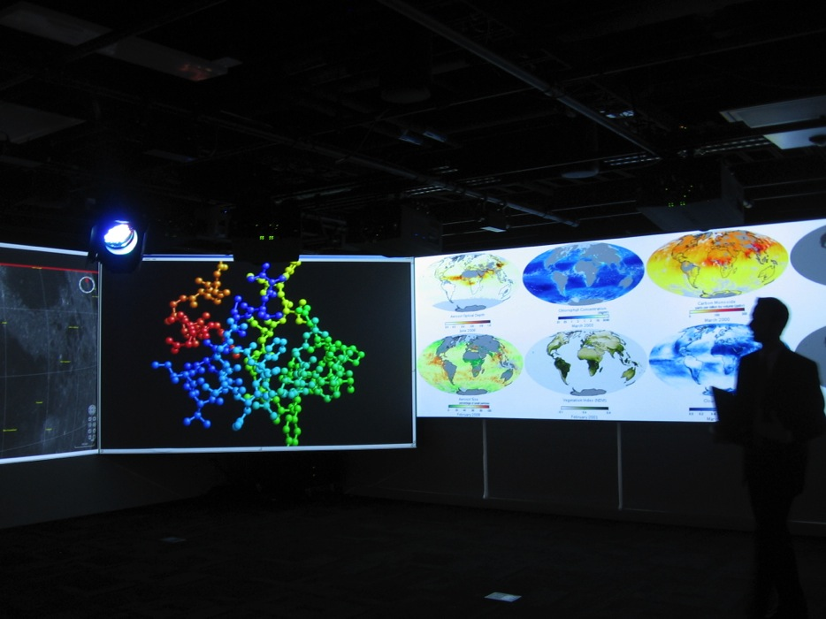
Thank you!
Data Visualization Studio - NCSU
Joan K. Lippincott
joan@cni.org
www.cni.org

